Slide 1
Third Party Risk Management [TPRM] Fundamentals
By Bharati Byahatti

Slide 2
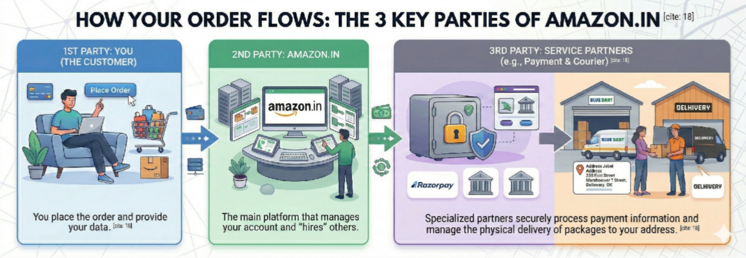
TPRM: Who is Third party
Who is Third Party:
A third party refers to an external entity, this can be an individual, an organization, or an external service provider that an organization engages with to provide products, services, or support.
Examples:
Tech & Digital: External companies handle your data and money.
PhonePe/Amazon Pay/Google Pay, Jio/Airtel (Home/office Wi-Fi).

Slide 3
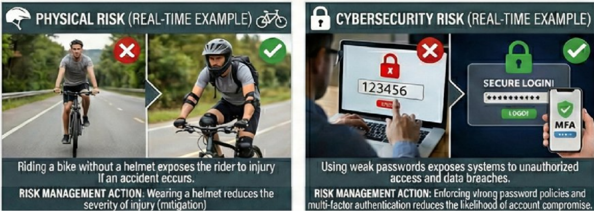
TPRM: What is Risk
Risk:The possibility of an event occurring that will have an impact (either positive or negative) on an organization's objectives.
Example: Riding a bicycle without helmet

Slide 4
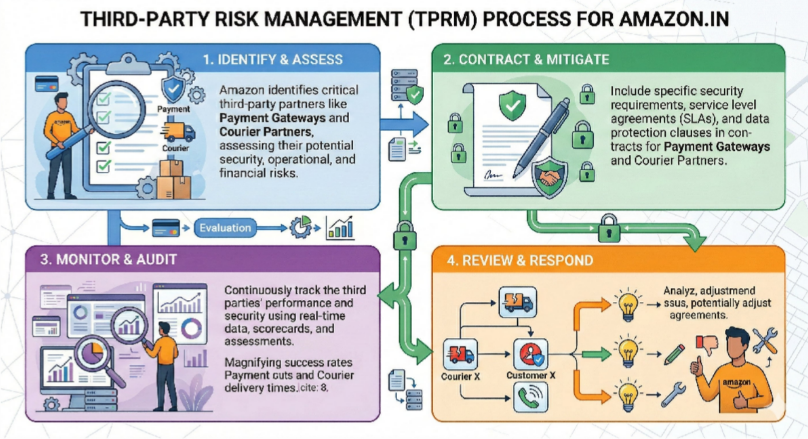
TPRM: What is TPRM
What is TPRM in Cybersecurity: It’s the process of managing risks from external vendors or service providers who access an organization’s systems or data. TPRM ensures these third parties follow good security practices to protect sensitive information and prevent breaches..

Slide 5
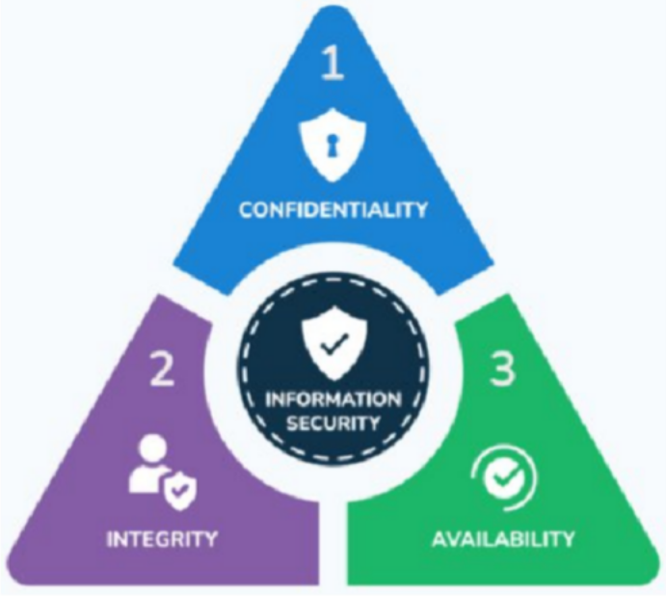
TPRM:CIA Triad
The traid is a fundamental model designed to guide policies for information security within an organization.
It focuses on three core principles:
Confidentiality: Preventing unauthorized disclosure of data. Examples: Encryption, access controls, user authentication.
Integrity: Ensuring data is accurate, consistent, and hasn't been improperly Modified or destroyed.
Examples: Hashing, digital signatures, version control, backup/recovery.
Availability: Guaranteeing timely and reliable access to information and systems for authorized users.
Examples: Redundancy, disaster recovery plans, load balancing.

Slide 6







TPRM: Why Third Parties - why organizations rely on third parties:
Cost Efficiency: Reducing expenses by outsourcing non-core tasks.
Access to Expertise: Getting specialized skills that may not exist internally.
Focus on Core Competencies: Allowing internal teams to concentrate on strategic work.
Scalability and Flexibility: Easily adjusting resources based on business needs.
Speed and Efficiency: Faster execution through experienced third-party providers. Innovation & Competitive Advantage: Gaining new technology and industry best practices. Resource Optimization: Better use of time, budget, and workforce.

Slide 7
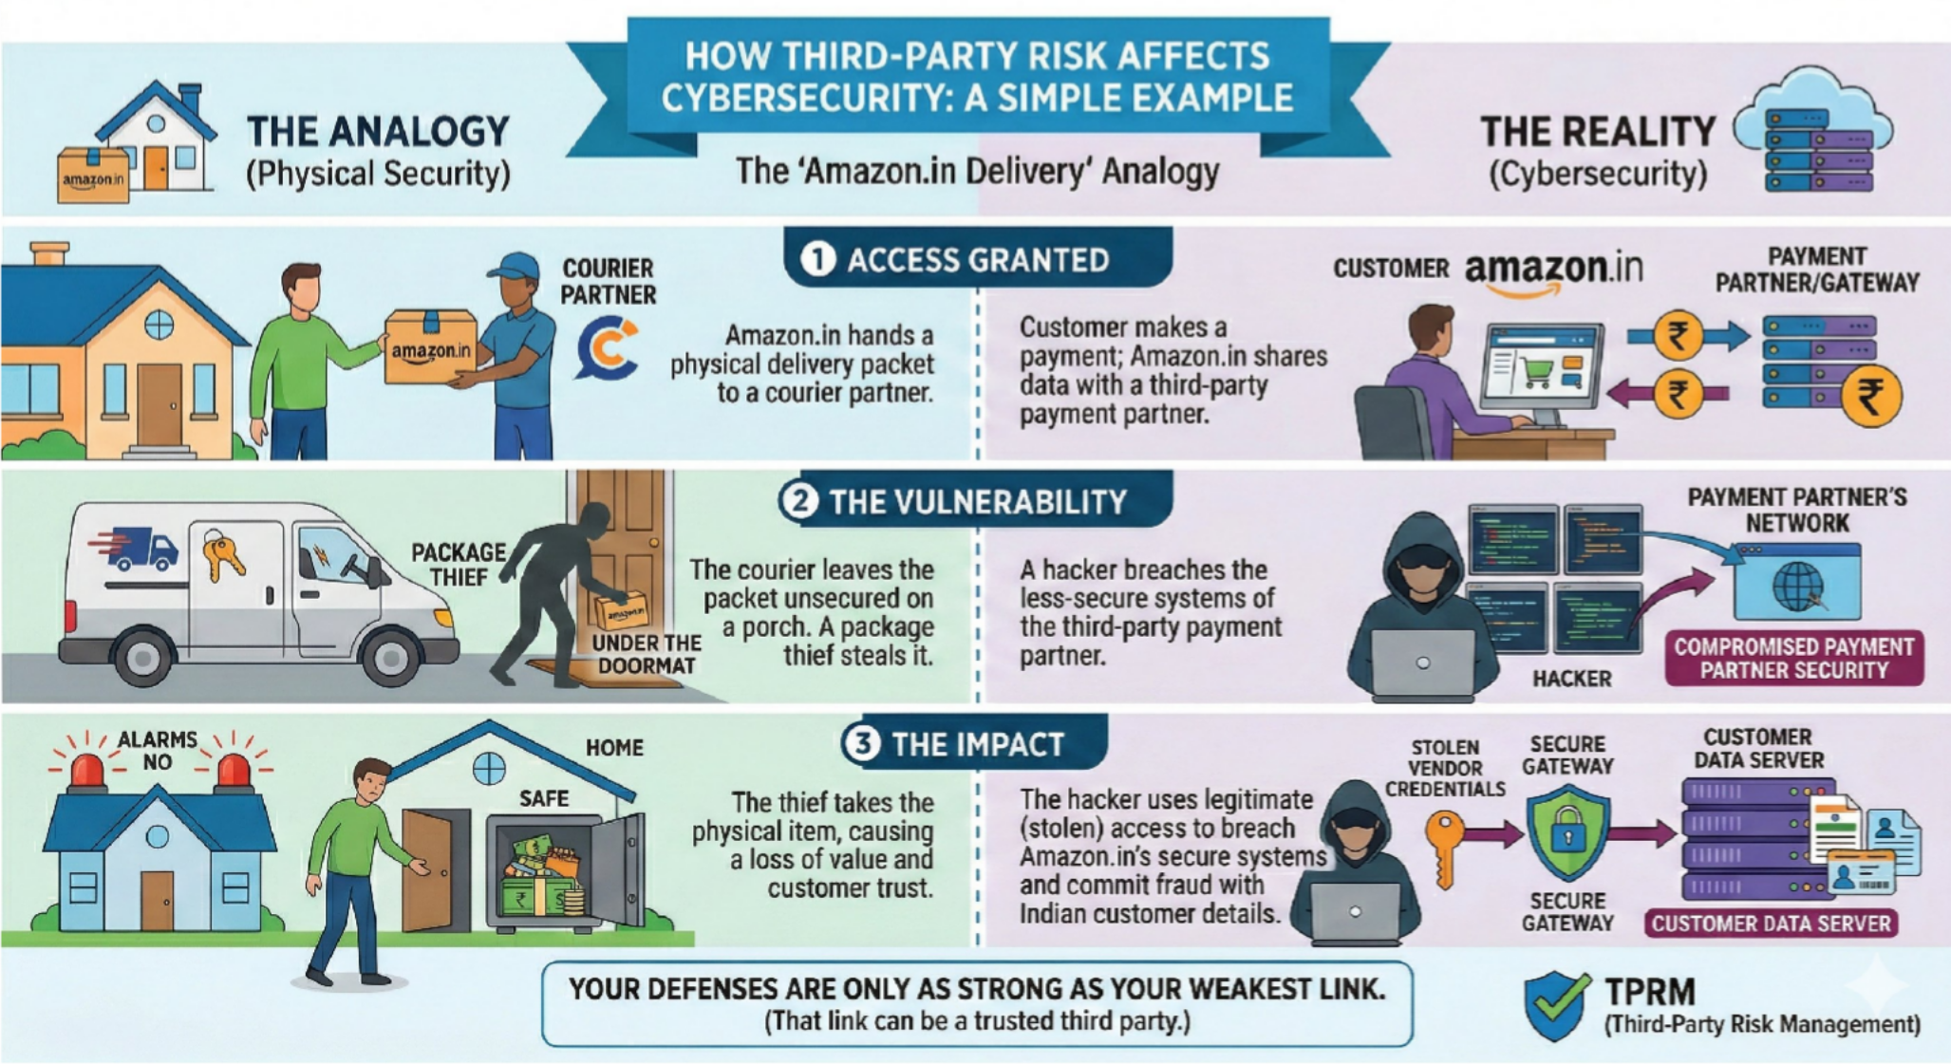
TPRM: Real and simple example

Slide 8
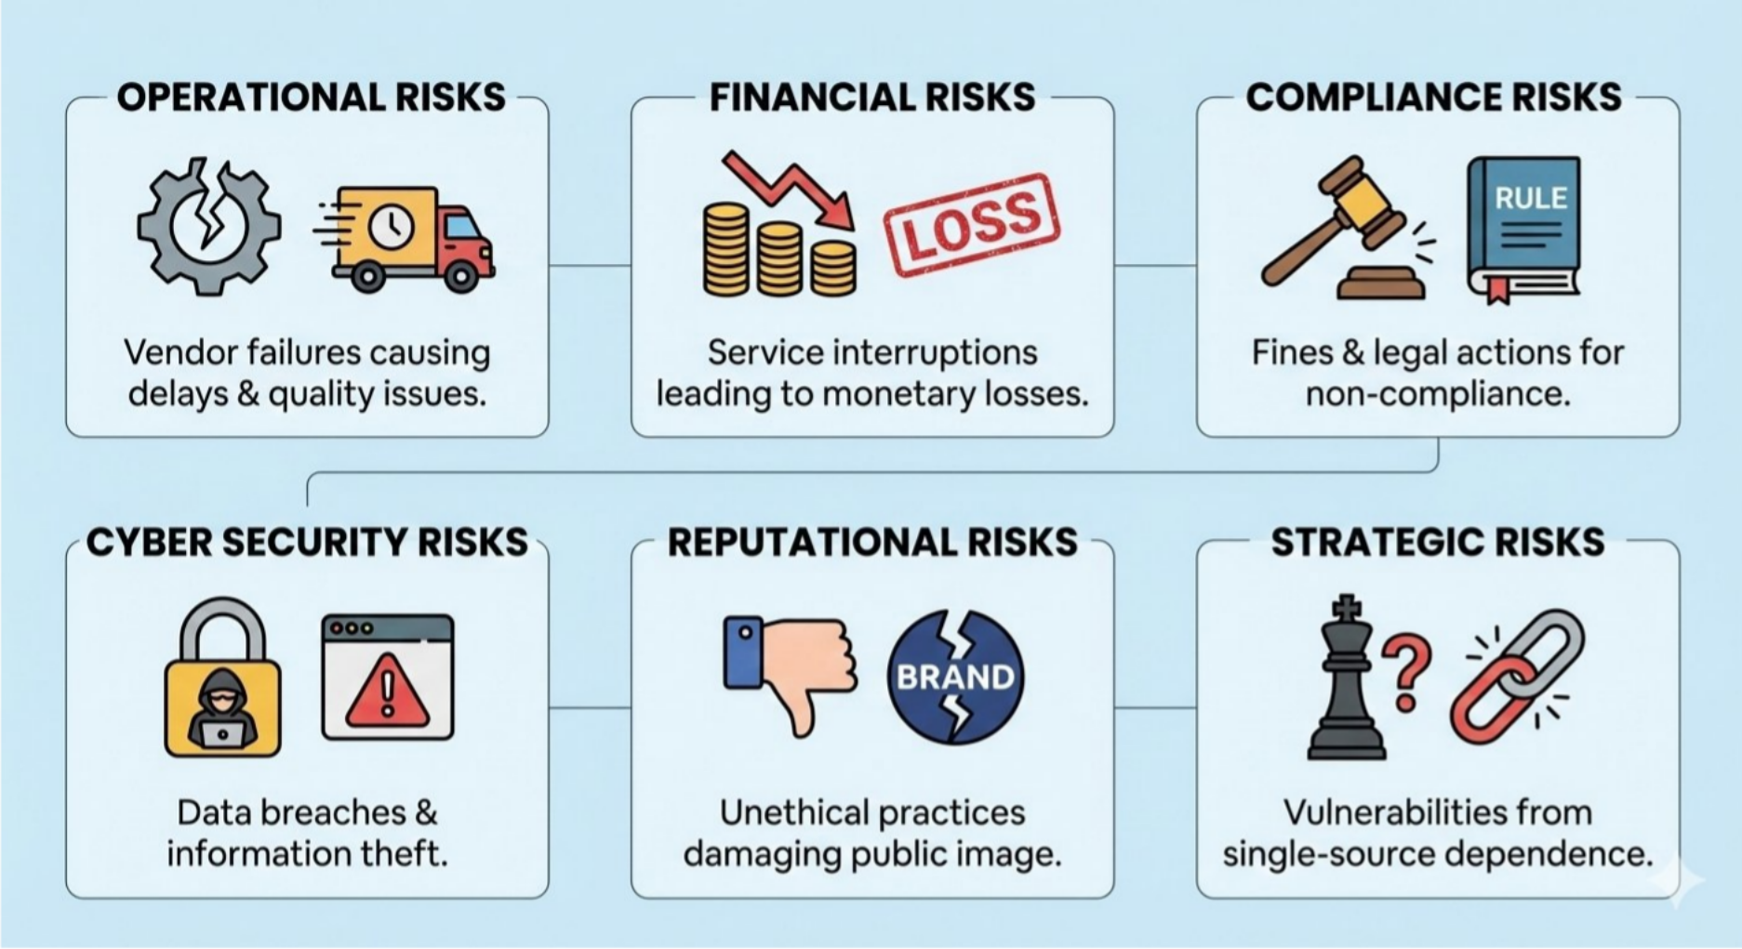
TPRM: Risks with Third parties

Slide 9
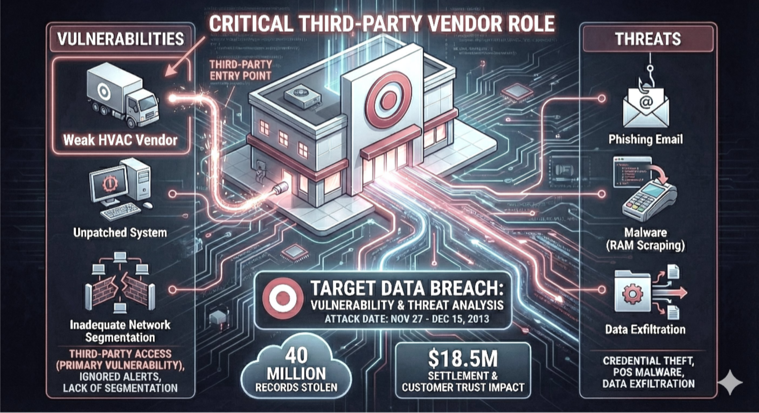
TPRM: Real word cases- Target data breach due to weakness in Third party

Slide 10
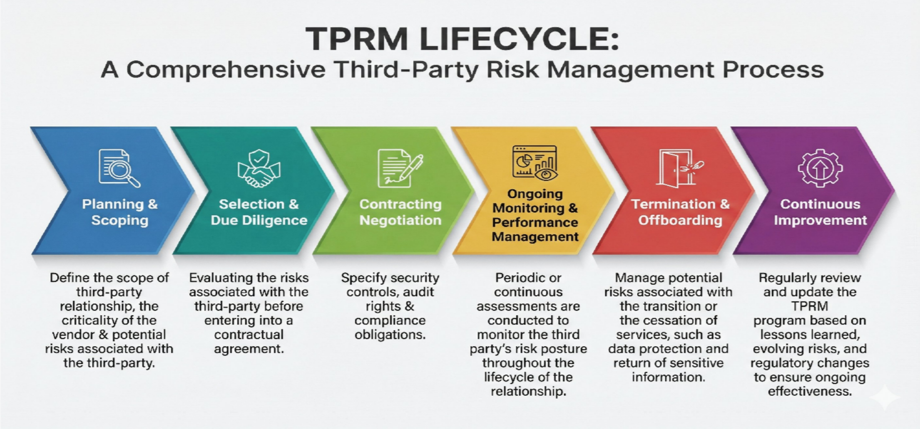
TPRM: TPRM Lifecycle

Slide 11
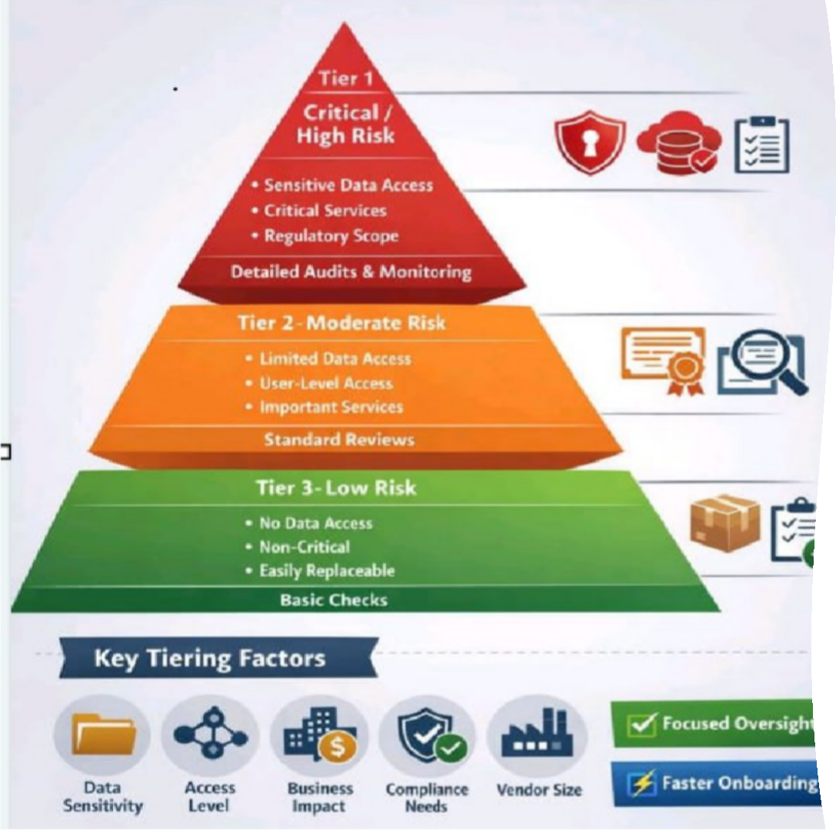
TPRM: How to Tier Third parties
Tier -1: Critical/High risk
Most critical to business operations.
Tier- 2: Moderate Risk
Important but not business-critical.
Tier- 3: Low Risk
Minimal impact on operations or data.
* Source: Abhishek Tanwar via LinkedIn

Slide 12
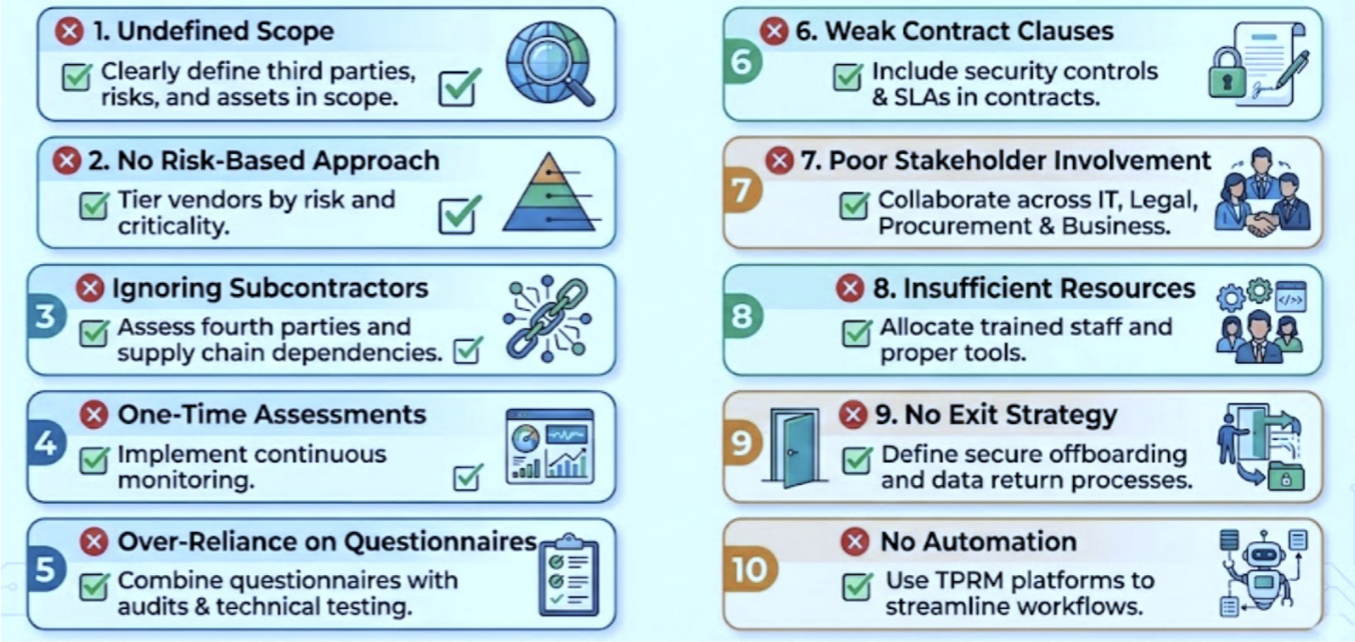
TPRM: 10 Mistakes in TPRM & How to Avoid them

Slide 13
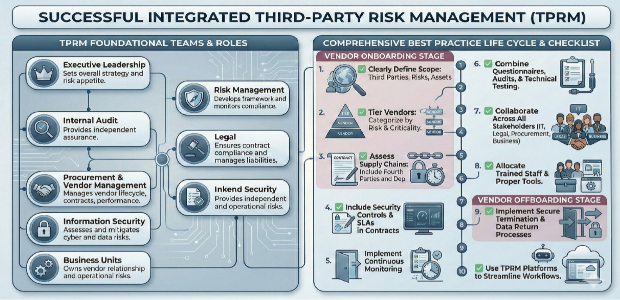
TPRM: Integrated TPRM Process

Slide 14
Thank you!

